Slide 1

Olist Store Analysis
By: Souvik, Vaibhav, Ayisha and Akshay
Last data refresh:
5/26/2024 5:50:09 PM UTC
Downloaded at:
5/26/2024 6:05:21 PM UTC

Slide 2

Contents
Introduction
KPIs
Dashboard
KPI Insights
Conclusion

Slide 3
Introduction
Olist is a Brazilian e-commerce platform that connects small and medium-sized businesses to larger marketplaces. Olist Store Analytics would likely refer to the analytical tools and reports provided to Olist store owners to track and analyze various aspects of their business performance on the platform. These analytics include data on sales, customer behavior, product performance, and other relevant metrics.
Specifically, Olist Store Analytics offer insights into:
Sales Performance: Tracking sales data, revenue, and growth over time.
Customer Behavior: Analyzing customer interactions, preferences, and purchase patterns.
Product Performance: Assessing the popularity and success of individual products.
Market Trends: Identifying trends within the Olist marketplace and adapting strategies accordingly.
Optimization Opportunities: Discovering areas for improvement and optimization in the online store.

Slide 4
KPIs
Weekday Vs Weekend (order purchase timestamp) Payment Statistics
Number of Orders with review score 5 and payment type as credit card.
Year wise Sales
Average price and payment values from customers of Sao Paulo city
Relationship between shipping days (order delivered customer date – order purchase timestamp) Vs review scores.
1
2
3
4
5
5

Slide 5
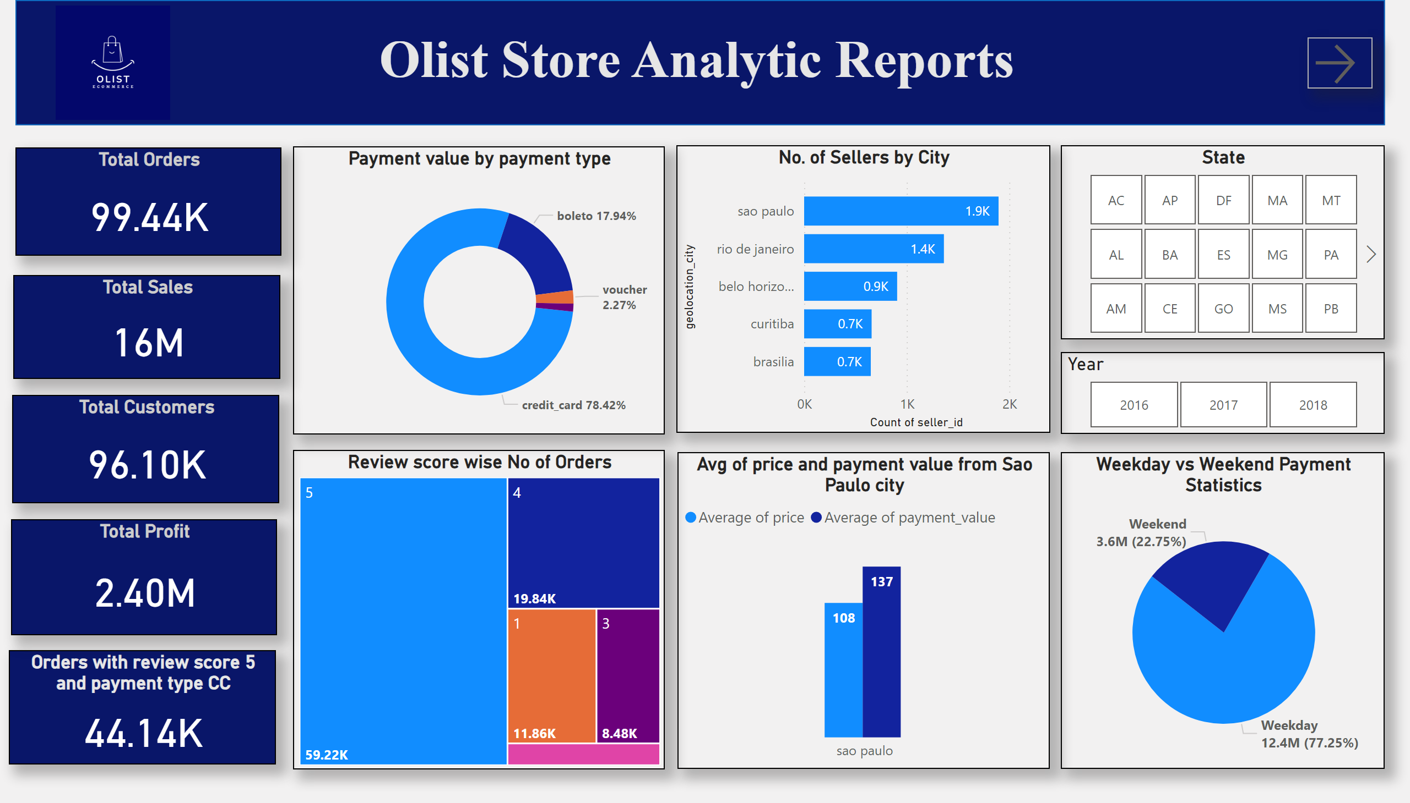
Report 1
Notes:
Total Orders
No alt text provided
Total Sales
No alt text provided
Total Customers
No alt text provided
Weekday vs Weekend Payment Statistics
No alt text provided
Avg of price and payment value from Sao Paulo city
No alt text provided
Orders with review score 5 and payment type CC
No alt text provided
Payment value by payment type
No alt text provided
shape
No alt text provided
No. of Sellers by City
No alt text provided
Review score wise No of Orders
No alt text provided
Total Profit
No alt text provided
textbox
No alt text provided
image
No alt text provided
State
No alt text provided
Year
No alt text provided
actionButton
No alt text provided

Slide 6
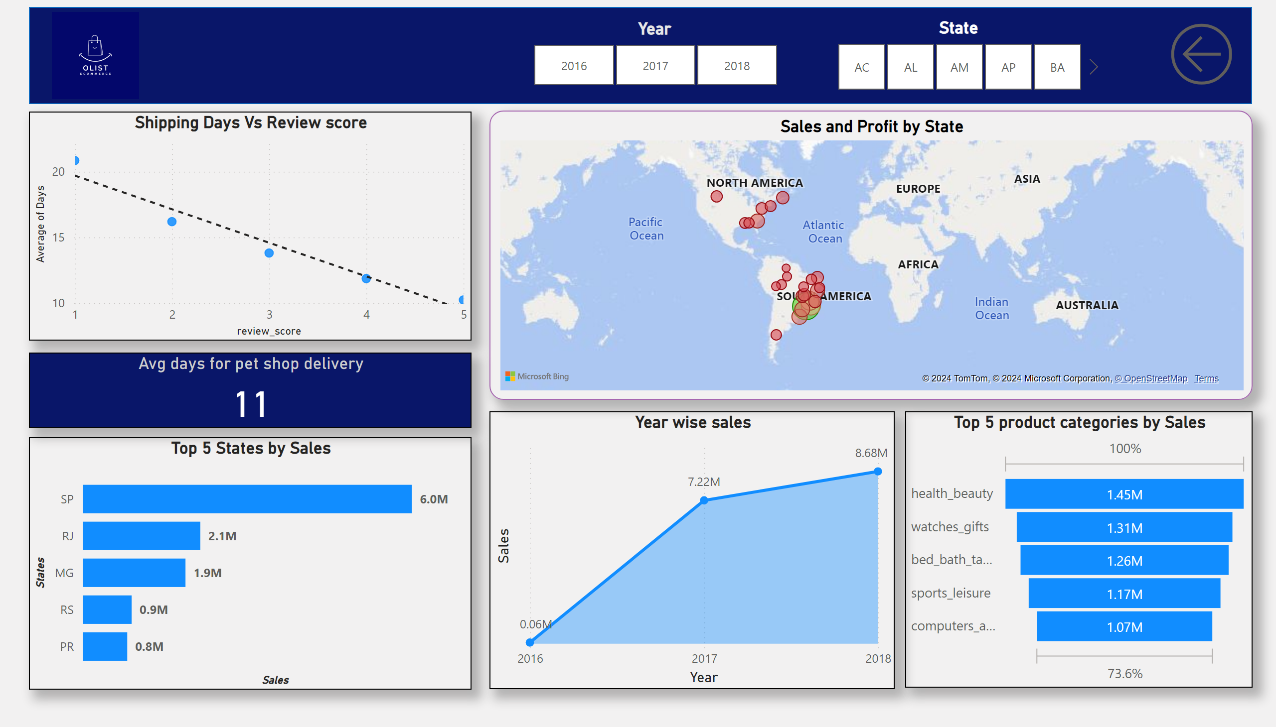
Report 2
Notes:
Shipping Days Vs Review score
No alt text provided
Top 5 States by Sales
No alt text provided
Year wise sales
No alt text provided
Top 5 product categories by Sales
No alt text provided
Sales and Profit by State
No alt text provided
shape
No alt text provided
Avg days for pet shop delivery
No alt text provided
image
No alt text provided
State
No alt text provided
Year
No alt text provided
actionButton
No alt text provided

Slide 7
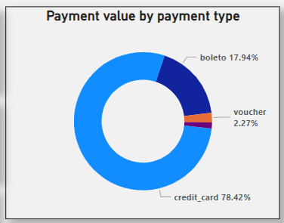
Weekday Vs Weekend (order purchase timestamp) Payment Statistics
Payment value analysis reveals a significant dominance of credit card transactions, constituting a substantial 78.42% of the total payment volume. Credit cards emerge as the preferred mode of payment, reflecting consumer confidence and convenience in utilizing credit-based financial instruments.
On the contrary, debit card transactions contribute a modest 2.27% to the overall payment value.

Slide 8
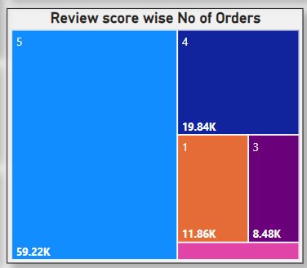
Number of Orders with review score 5 and payment type as credit card.
The analysis emphasizes orders with a perfect review score of 5, indicating utmost customer satisfaction. Among these orders, a significant 59k exhibit this exceptional rating, reflecting high customer contentment.
In contrast, only 3,200 orders have a review score of 2, suggesting a minor subset of dissatisfied customers.

Slide 9
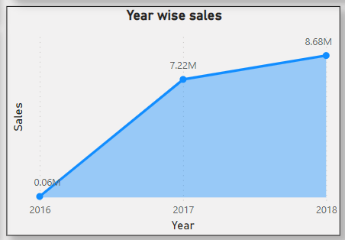
Year Wise Sales
In 2016, sales started at 0.6 million units, indicating a relatively modest beginning. However, there was a remarkable surge in 2017, with sales skyrocketing to 7.22 million units, marking an unprecedented growth rate.
Building upon the momentum of 2017, 2018 witnessed further growth, reaching 8.68 million units. This consistent upward trend indicates the sustainability of the market expansion and highlights the effectiveness of the business strategies implemented during this period.

Slide 10
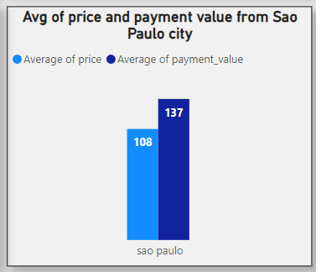
Average price and payment values from customers of Sao Paulo city
The analysis of average price and payment values from customers in Sao Paulo city reveals valuable insights into consumer behavior and spending patterns.
With an average price of $108 and a payment value of $137, it's evident that customers in this region are willing to spend more than the average price. This suggests a relatively affluent consumer base or a market with a higher willingness to pay for products or services

Slide 11
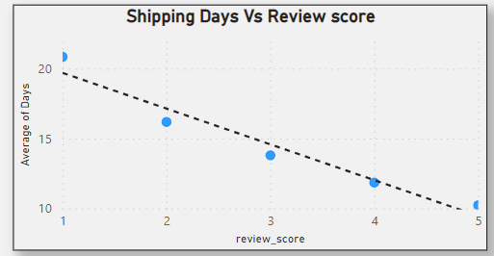
Relationship between shipping days Vs review scores.
The chart clearly illustrates a trend: as the number of delivery days decreases, the review score consistently improves. This suggests a correlation between shorter delivery times and higher ratings.
However, it's important to acknowledge that review scores are influenced by multiple factors beyond just delivery speed. Customer satisfaction, quality of interaction, and product/service excellence also play significant roles in determining ratings.

Slide 12
Conclusion
Decreasing delivery times correlate with higher product review scores, indicating heightened customer satisfaction with faster deliveries.
The rise in credit card usage can be attributed to the enhanced convenience and accessibility they offer, including interest-free installment options. This shift suggests a decreasing reliance on cash transactions, indicating a need to incentivize credit card usage.
Analysis reveals that the majority of our profits originate from major cities such as Sao Paulo and Rio de Janeiro. The top-performing product categories in these cities include health and beauty, watches, sports items, and computers. This insight underscores the importance of tailoring our offerings to match the preferences of urban consumers.
While our sales demonstrated impressive growth from 2016 to 2017, the subsequent year's performance in 2018, although still strong, did not match the previous year's success. This discrepancy warrants a thorough examination of market competition and potential expansion strategies to sustain growth.
Sales data highlights Sao Paulo as the leading contributor to both sales volume and profit. This success prompts a critical evaluation of our performance in the capital city of Brasilia, where our presence and profitability are comparatively weaker. Identifying the key factors contributing to our success in Sao Paulo could provide valuable insights for replicating our achievements in Brasilia.

Slide 13
Thank You

